Slide 1
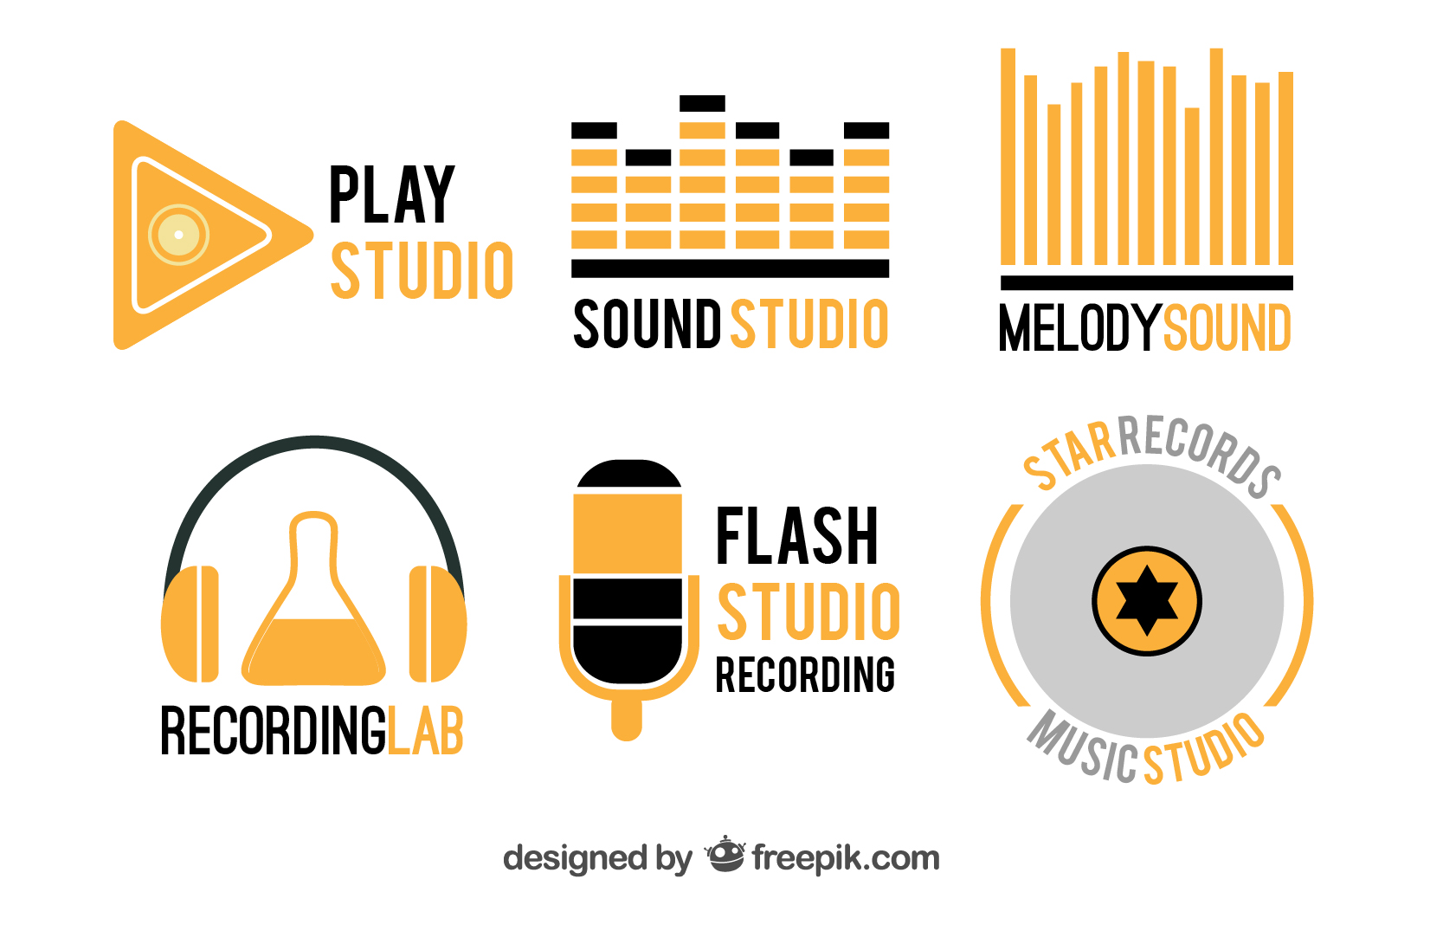

FL Studio
(DAW) Digital Audio Workstation

Slide 2
Music Studio Options
Beginner - iPad and Android tablets
Sound Trap
Music Maker Jam
Walk Band
Medium - MacOS
GarageBand
Advanced – Windows
FL Studio 12

Slide 3
Basic Features
5 buttons you need to get started as a beginner
View Playlist
View Channel Rack
View Piano Roll
View Browser / Plugin Picker
View Mixer

Slide 4
Resources
BusyWorksBeats

Slide 5
Time for Demo

